Slide 1




IMPLEMENTING QSVM ON ACTUAL QUANTUM DEVICES
Submitted to
Dr. Ripul Ghosh

Slide 2
PROBLEM STATEMENT
f
This project aims to implement Quantum Support Vector Machines (QSVM) on actual quantum devices and simulators using the Qiskit library in conjunction with Amazon Braket. The core objective is to evaluate and compare the performance efficiency of QSVM implementations across various quantum hardware and simulation environments. The comparison will focus on key statistical metrics including recall, precision, F1 score, and accuracy, alongside execution time.

Slide 3
OBJECTIVES
f
This analysis seeks to determine the practical viability and performance advantages of quantum-enhanced SVM algorithms, providing insights into their effectiveness relative to classical approaches and their potential for real-world applications.
Performance Evaluation
Execution Time Analysis
Comparative Study
Insight Generation

Slide 4
QSVM - HOW IT WORKS
Quantum Support Vector Machine (QSVM) is a quantum computing approach to the classical Support Vector Machine (SVM) algorithm, which is used for classification tasks in machine learning.
NOTE: especially for complex or high-dimensional data.
In QSVM, it takes your data convert it into a format Quantum computers can handle, calculate how similar your data points are using quantum techniques, train a model to recognize patterns and then uses that model to predict the category of new data. This can potentially be more powerful or faster than traditional methods, especially for complex data

Slide 5
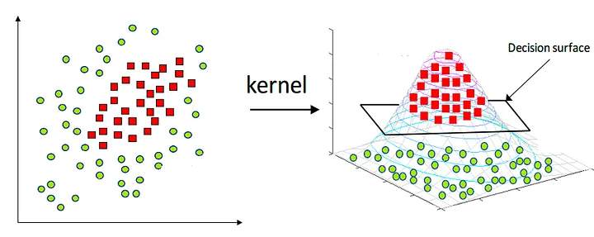
QSVM-KERNEL
A kernel is a mapping feature that takes data points and maps them into a new domain which, in this case, makes the dataset easier to classify. It works, for instance, by adding new dimensions to the data (i.e. the image above) or redistributing the dataset in the given domain.

Slide 6


AMAZON BRAKET
QISKIT
Amazon Braket is a fully managed service designed to make quantum computing accessible to a broader audience. It allows users to harness the power of quantum processors alongside classical computing resources. Key Features are Quantum Processing (quantum processors, D-Wave, IonQ, and Rigetti), Hybrid Quantum-Classical Computing, and Quantum Simulation.
Qiskit is an open-source quantum computing software development framework developed by IBM. It provides tools for creating, simulating, and executing quantum programs on quantum computers and simulators.

Slide 7
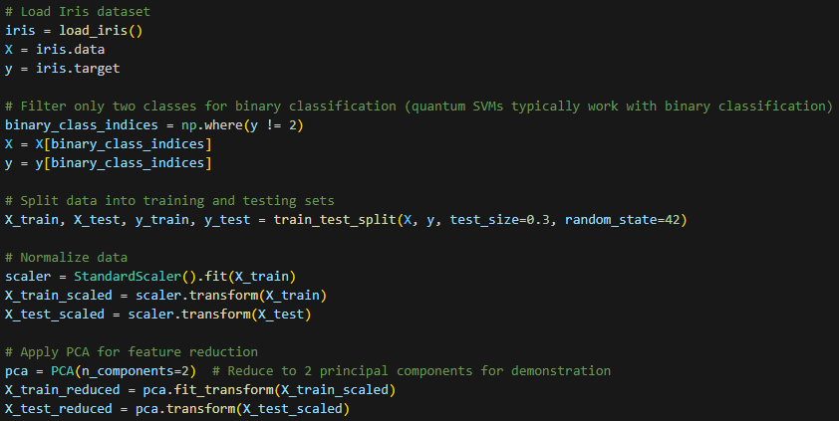
DATASET
Here we have used the Iris dataset, normalized it using Standard Scaler(mean=0 and variance=1), then applied PCA to compress data.

Slide 8
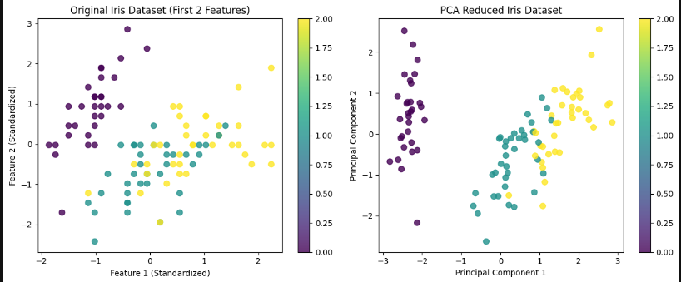

Slide 9
SIMULATORS V/S REAL QUANTUM DEVICE
Hardware Implementation: Uses physical quantum systems (e.g., superconducting qubits, trapped ions) t
Quantum Noise: Affected by quantum noise and decoherence, leading to potential errors.
Scalability: Limited scalability due to current technological constraints.
Speed: Potentially faster for specific problems compared to classical computers.
Cost: Expensive to build and maintain due to the advanced technology and precise conditions needed.
Software Implementation: Runs on classical computers and uses algorithms to simulate.
No Quantum Noise: Free from quantum noise and decoherence, providing idealized results.
Scalability: Limited by classical computational resources; Speed: Slower compared to potential speedups offered by actual quantum devices for certain quantum algorithms.
Cost: Generally more accessible and cost-effective as it utilizes existing classical computing infrastructure.

Slide 10
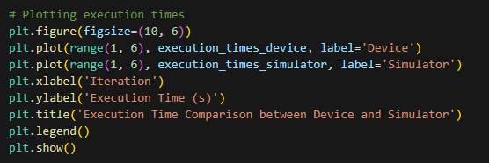
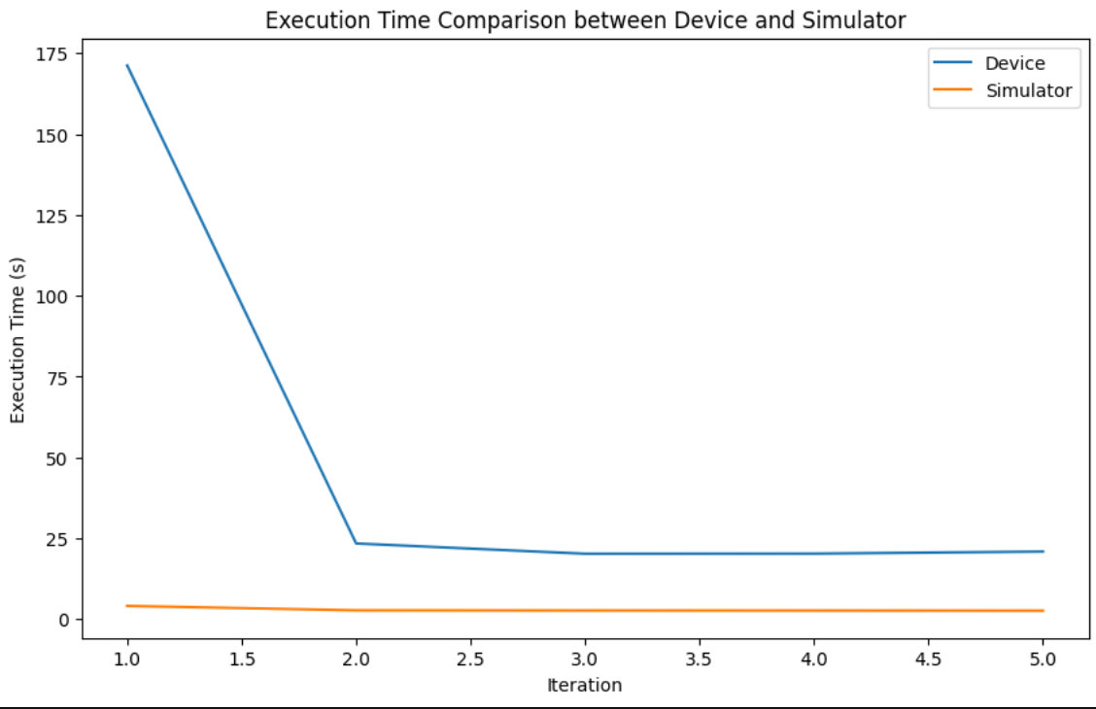
IMPLEMENTATION DETAILS

Slide 11
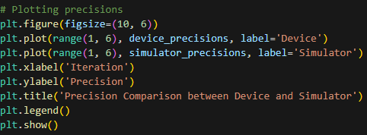
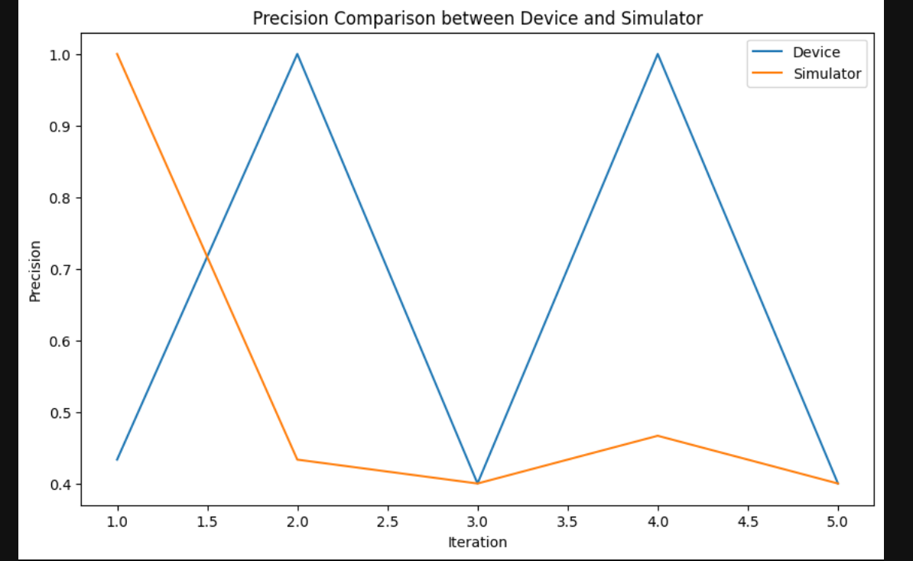
IMPLEMENTATION DETAILS

Slide 12
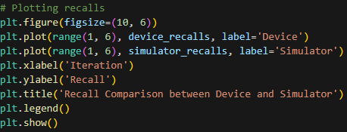
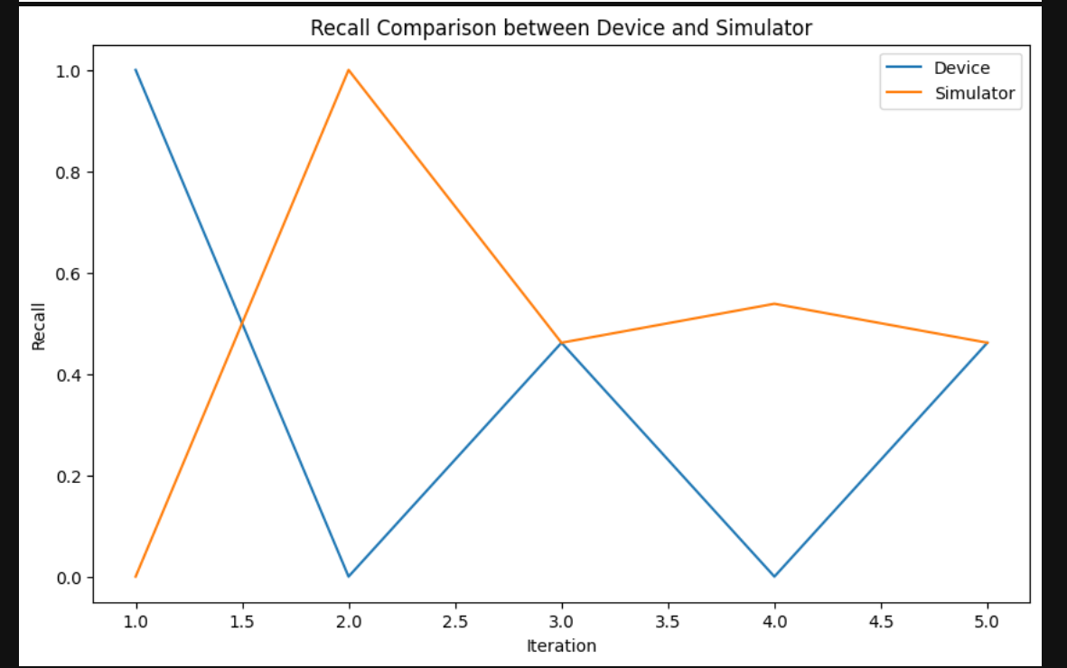
IMPLEMENTATION DETAILS

Slide 13
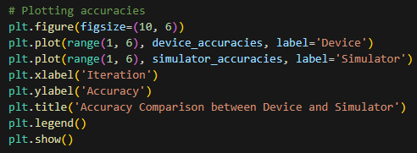
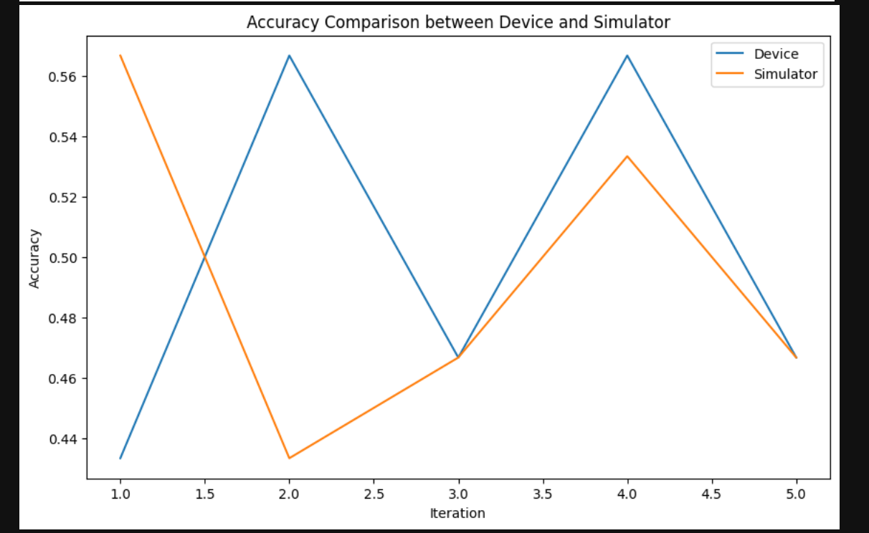
IMPLEMENTATION DETAILS

Slide 14
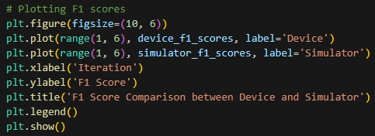
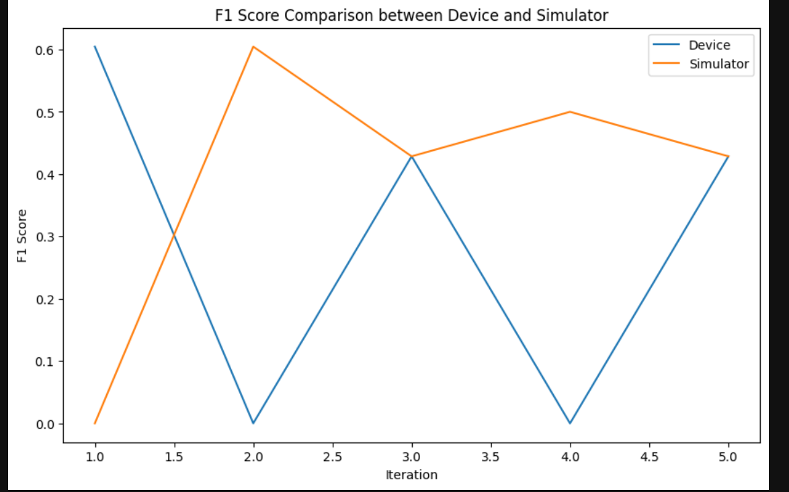
IMPLEMENTATION DETAILS

Slide 15
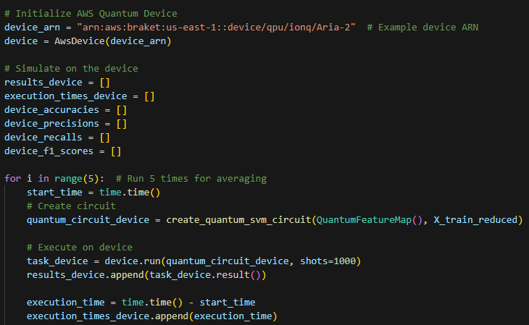

Slide 16
QUANTUM USE CASES
Medical Diagnosis: such as genetic information or medical images, to classify and predict diseases more accurately
Cybersecurity: In finance, QSVMs can detect fraudulent transactions by analyzing large volumes of transaction data to identify unusual patterns.
Drug Discovery: QSVMs could be used to classify and analyze molecular structures, aiding in the discovery of new drugs.

Slide 17
THANK YOU
Presentation by:
SRISHTI GUPTA

